Slide 1

UNITS : 1- 2
EE 475 HIGH VOLTAGE TECHNIQUES I
Prof. Dr. Sezai Dinçer

Slide 2
EE 475 (3+0)
Breakdown mechanisms in insulating materials are studied. Topics are; I-Vcharacteristics of gases. Electron emission processes. Ionization and deionization. Townsend and Streamer breakdown mechanisms. Breakdown in electronegative gases. Corona discharges and loses. Breakdown mechanisms in
solid and liquid insulations

Slide 3
Course Contents

Slide 4
Introduction

Slide 5
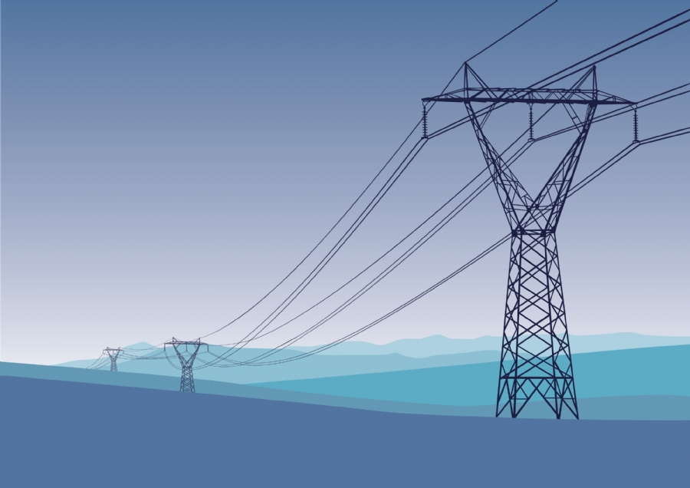

Slide 6
INTRODUCTION
The power transmitted is proportional with the product of voltage magnitude and current magnitude. In order to transfer
bulks of power to distant locations, transmission voltage level must be increased rather than the current carrying capacity
since the usage of super conductors is not feasible and reliable considering the present technology.
Therefore, the only solution is the increase the transmission system voltage levels and insulation of the system plays a vital role.

Slide 7
Breakdown

Slide 8
Free Path of Particles in a Gas Medium
E
Free path is the distance traversed between successive collisions.
It is a random quantity

Slide 9
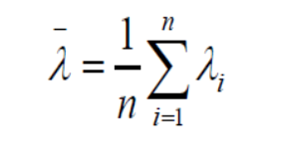
Collision Cross section and Mean Free Path
HARD SPHERE MODEL
Moving particles with radius of r2 and molecules with radius of r1 are solid spheres. Evert time the centers of particles come to a distance of
r1 + r2 a collision will occur. The area presented by a molecule to the incoming particle is .which is the collision cross section.
Where is the mean free path.
N is the number of gas molecules per unit volume

Slide 10
Mean Free Path of Particles
Collision cross section presented

Slide 11
Clausis Law
At x = λ the particles arriving the gas layer is .
The mean number of collisions is per unit length
In the interval the mean number of collisions is
Therefore,
(- sign indicates loss due to scattering) organizing terms
and integrating both sides gives

Slide 12
Distribution of Free Paths
collision cross section

Slide 13
Current - Voltage relationship in a gas insulated gap

Slide 14
I-V Charasteristic

Slide 15
I-V Charasteristic

Slide 16
Townsends First Ionization Coefficient
E
Paralel Field gap filled with gas molecules. dx is the gas layer at x distance away from cathode.

Slide 17
α , Townsends First Ionization Coefficient

Slide 18
α , Townsends First Ionization Coefficient
For a gap setting of x= d,
In the steady state

Slide 19
The First Ionization Coefficient
The above expression is simply the equation of a straight line. Therefo0re , the slope yields the first ionization coeefficient
and the intercept defines the photoelectric current.

Slide 20
Townsends First Ionization Coefficient in terms of Gas Constants
q is the electronic charge, E: applied field direction. λei is the path along the field direction.
Wi : ionization energy
E
Condition for ionization
Ui : ionization potential
Free path of the electron for ionization

Slide 21
Townsends First Ionization Coefficient in terms of Gas Constants
For an electron with mean free path , the probability of its free path to be at least equal to
is .
The mean number of collisions in terms of mean free path is
Therefore ionization coefficient is
, define = Ap (A is the gas constant and p is the pressure) , AUi = B ( B is another gas constant)
Hence in terms of gas constants , , ,

Slide 22
Typical Gas Constants

Slide 23
Pressure Reduced Field E/P
E/P is termed as the Pressure Reduced Field. E is the applied electric field magnitude
And p is the pressure of the gas insulant.
Assume that p = 760 torrs , with gap distance of 4 cms. In order to produce
E/P = 100 find the required voltage for a uniform gap.
V = (E/p) p d = 100x760x4 = 304000 Volts

Slide 24
Dependence of the first ionization coefficient on E/P

Slide 25
Ionization Growth Curves

